Slide 1
Super widefield particle tracking in near real-time via image stitching
Sean MacKenzie, Rami Dabit, Pete Li
ECE 278A

Slide 2
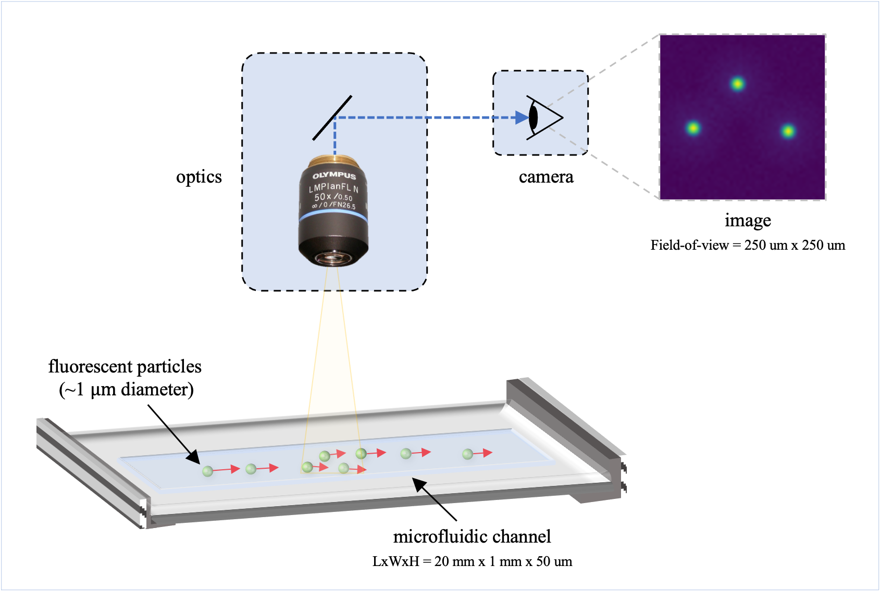
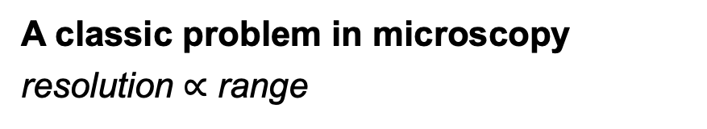
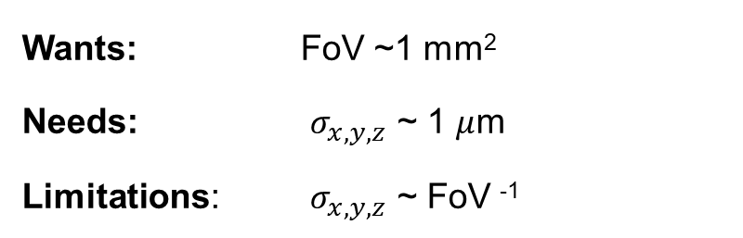
Introduction
Presenter: Sean
Application: Microfluidic Particle Tracking
A classic problem in microscopy
resolution $∝$ range
For example, for 20X magnification:
Field-of-view (FoV; i.e. range) is ~250 um².
spatial (x, y, z) resolution is ~ FoV / 100.
Wants: FoV ~1 mm²
Needs: $σ_{x, y, z}$ ~ 1 $μ$m
Limitations: $σ_{x, y, z}$ ~ FoV ⁻¹
Notes:
Currently, this requires performing multiple experiments where each local region-of-interest is separately observed.
This has a significant drawback:
experimental conditions can vary unpredictably and uncontrollable, lowering experiment repeatability and confidence.

Slide 3
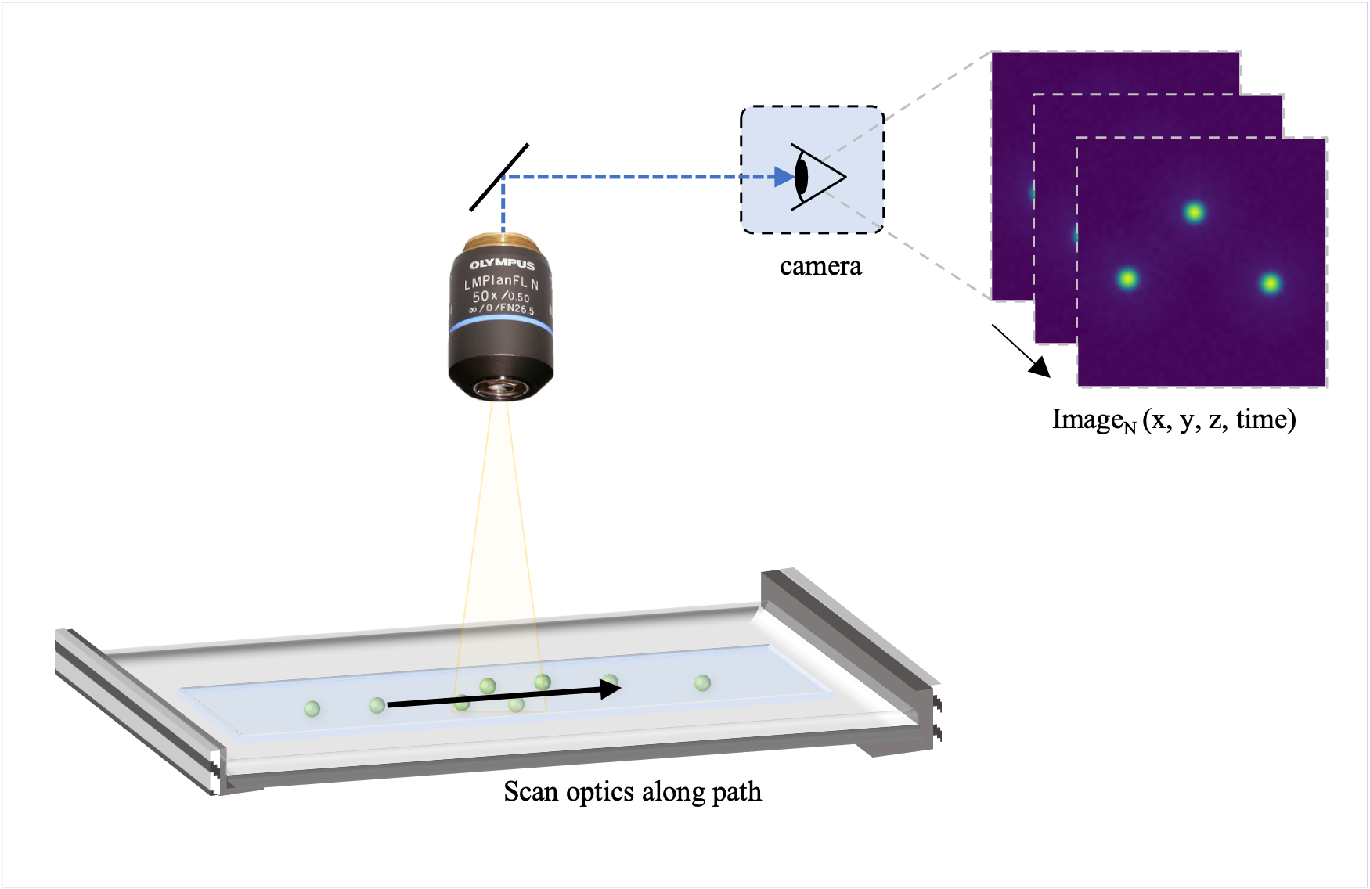
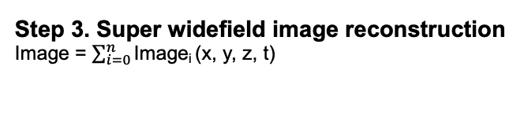
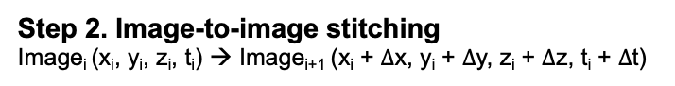
Super widefield imaging via image stitching
Presenter: Sean
Step 1. Image Acquisition
Image_{N} (x, y, z, time)
Image_{i}
Image_{i+1}
Image_{i+2}
Step 2. Image-to-image stitching
Image_{i} (x_{i}, y_{i}, z_{i}, t_{i}) → Image_{i+1} (x_{i} + $∆$x, y_{i} + $∆$y, z_{i} + $∆$z, t_{i} + $∆$t)
Step 3. Super widefield image reconstruction
Image = $\sum_{i=0}^{n}{\text{I}\text{mage}\text{i} \text{(}\text{x}\text{, }\text{y}\text{, }\text{z}\text{, }\text{t}\text{) }}$

Slide 4
Methods – Image Stitching
Presenter: Rami
Feature Detection
Laplacian of Gaussian (LoG)
Difference of Gaussian (DoG)
Determinant of Hessian (DoH)
Keypoint Preselection
Manually define # of key points
RANSAC
Least Median of Squares (LMS)
Keypoint Matching
Custom implementation: SSD minimization
SIFT
Nonlinear least squares
Stitching
Post-processing Bundle Adjustment

Slide 5
Methods – Dataset
Presenter: Sean
Dataset #1
Dataset #2
Synthetic particle images
Access to ground truth.
Standardized dataset.¹
Widely used.²
i
Investigate: Percent image ovlerap
% overlap
50%
25%
j
[1] M. Rossi, (2020)
[2] Pennathur Lab, Dept. of Mechanical Enginerring, UCSB
Image for 1D stitching
Widefield image for 2D stitching

Slide 6
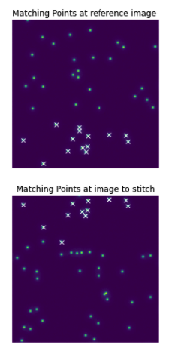
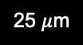
2. Keypoint Selection
Presenter: Rami and Peter
(1) Manually define # of key points
Manually define # of key points
RANSAC
Least Median of Squares (LMS)
key points = 14
Note to Peter and Rami:
You may want to add more info here
Image_{i}
matching points:
un-matched points:
25 $μ$m
Image_{i+1}

Slide 7
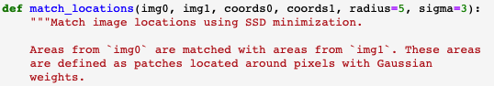
3. Keypoint Matching – SSD Minimization
Presenter: Peter
image_{i}
(img0)
Routine:
For key point₁ in image_{i} (img0)
Find the nearest key point in image_{i+1} (img1)
Calculate the pixel-wise “distance”:
Evaluate the Gaussian-weighted sum of squared difference over a pixel neighborhood (e.g. 11x11 pixels)
Return the pixel with the smallest distance.
Repeat for all key points_{1…N}
image_{i+1}
(img1)

Slide 8
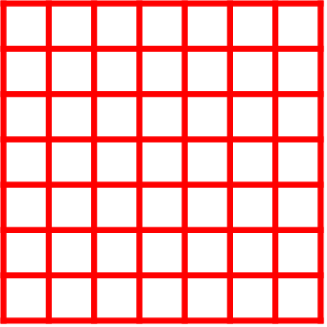
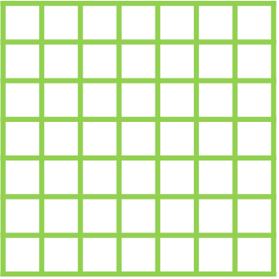
3. Keypoint Matching – SSD Minimization
Presenter: Peter
image_{i}
(img0)
1st step: compute diff matrix
point₁ at img1
Gaussian-weighted matrix
point₁ at img0
(radius=2 at the example)
center
radius
(
)
-
x
2*radius + 1
image_{i+1}
(img1)
point-wise product
2nd step: compute sum of elements in diff matrix

Slide 9
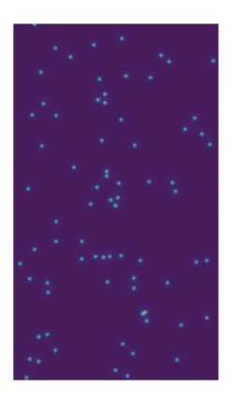
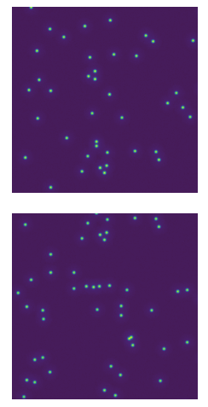
Algorithm Mechanism
Presenter: Peter
Update input images
Use detector to extract positions of the particles.
Update the # of key points
Obtain matching points by SSD minimization
Use matching points
to stitch images.
Start

Slide 10
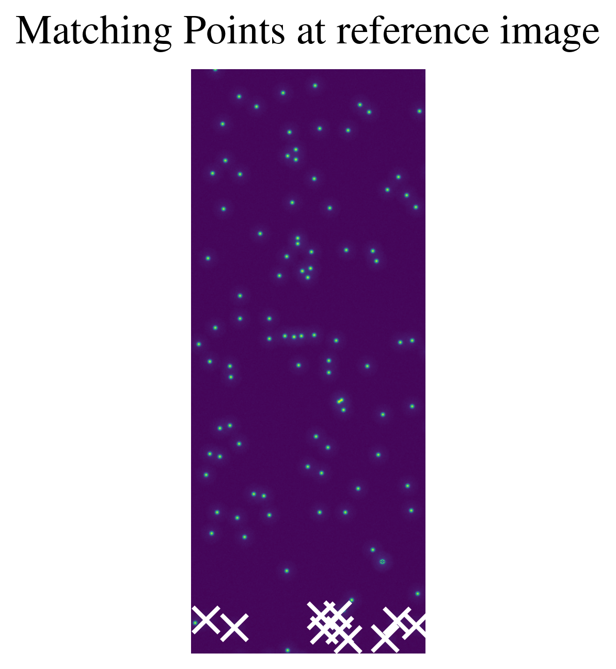
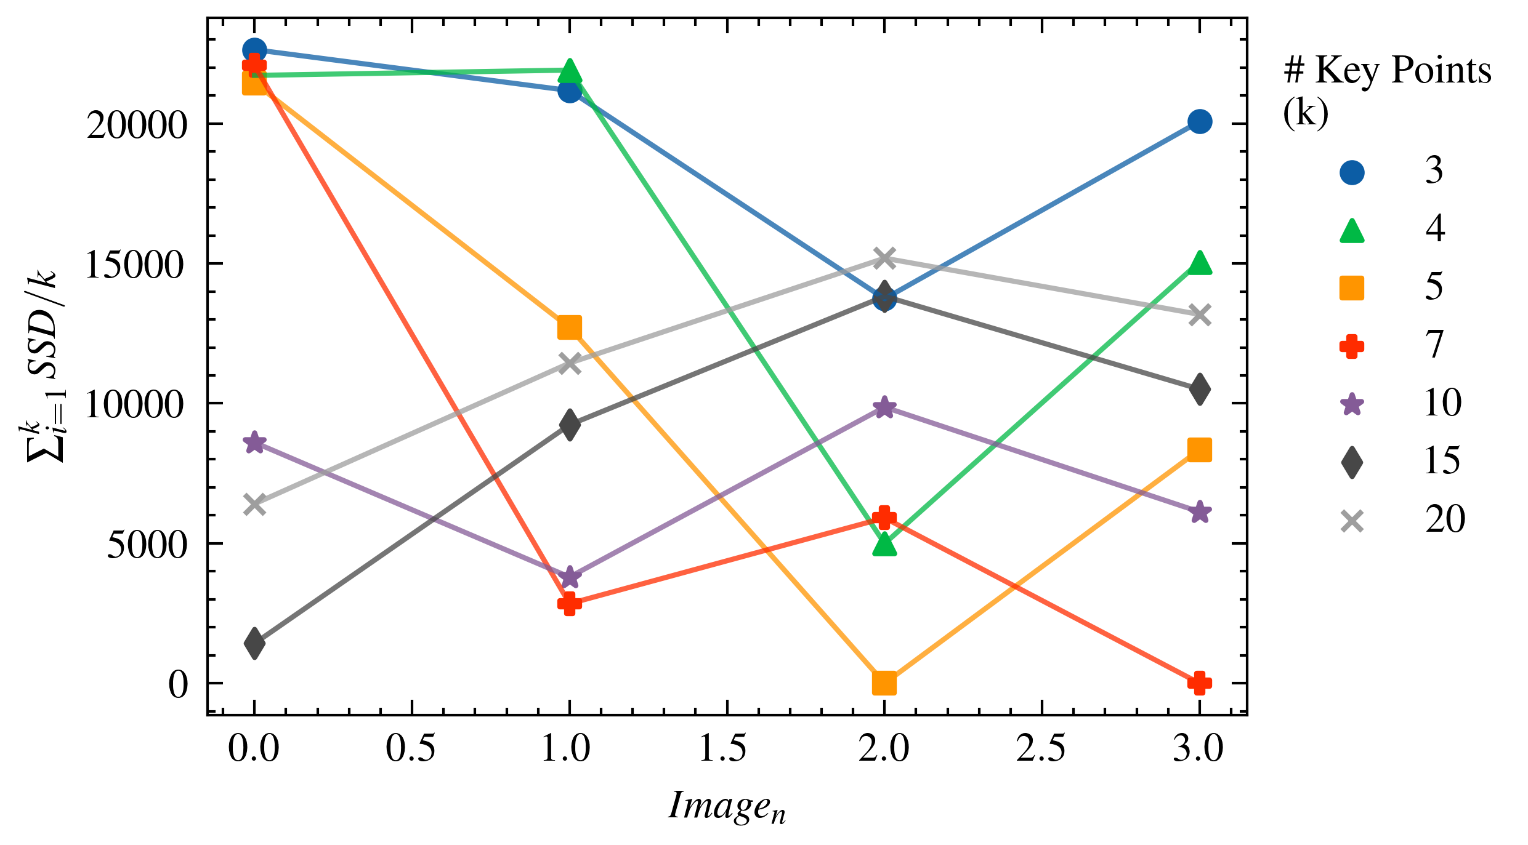
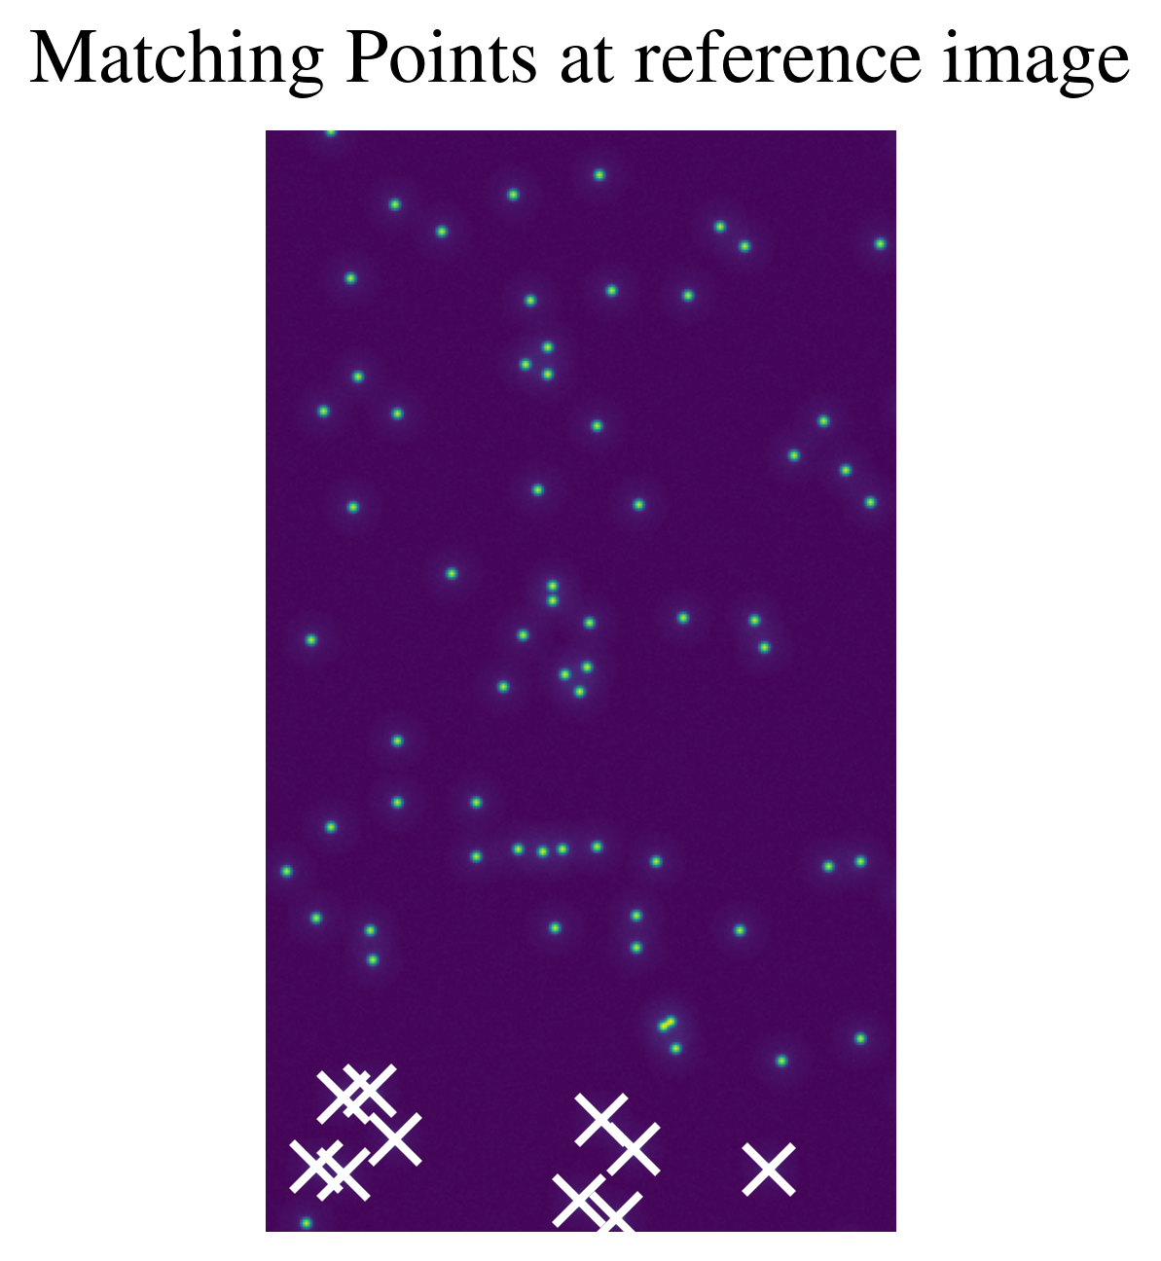
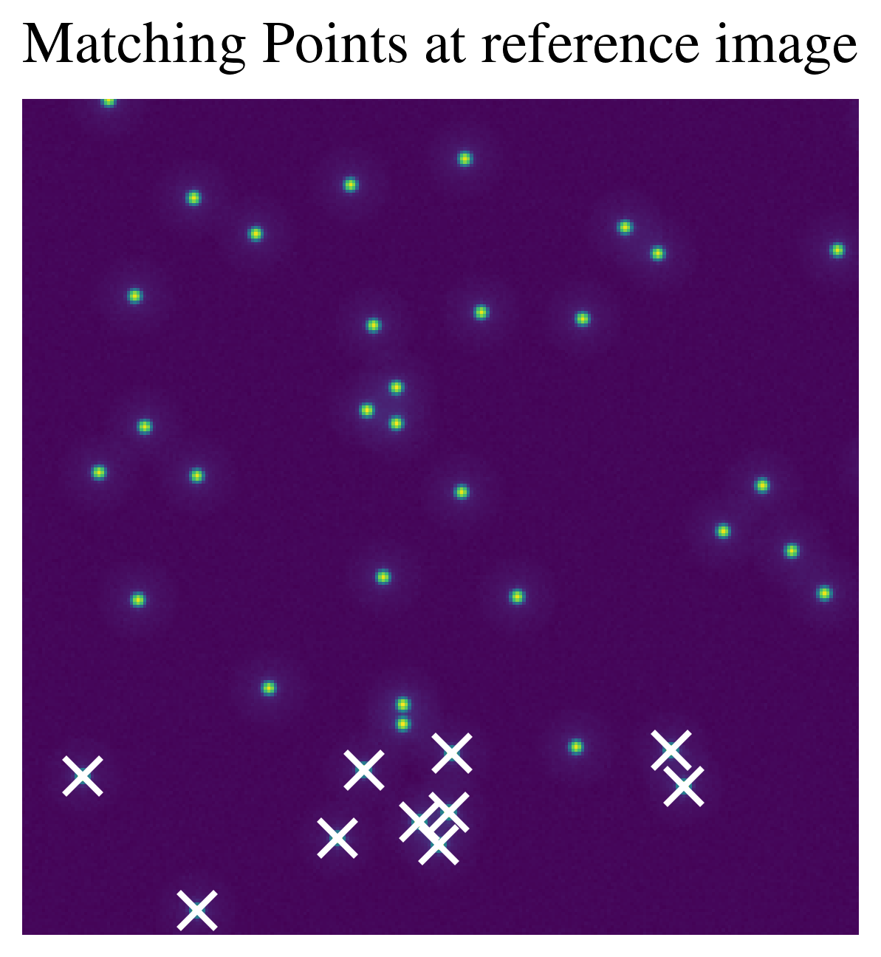
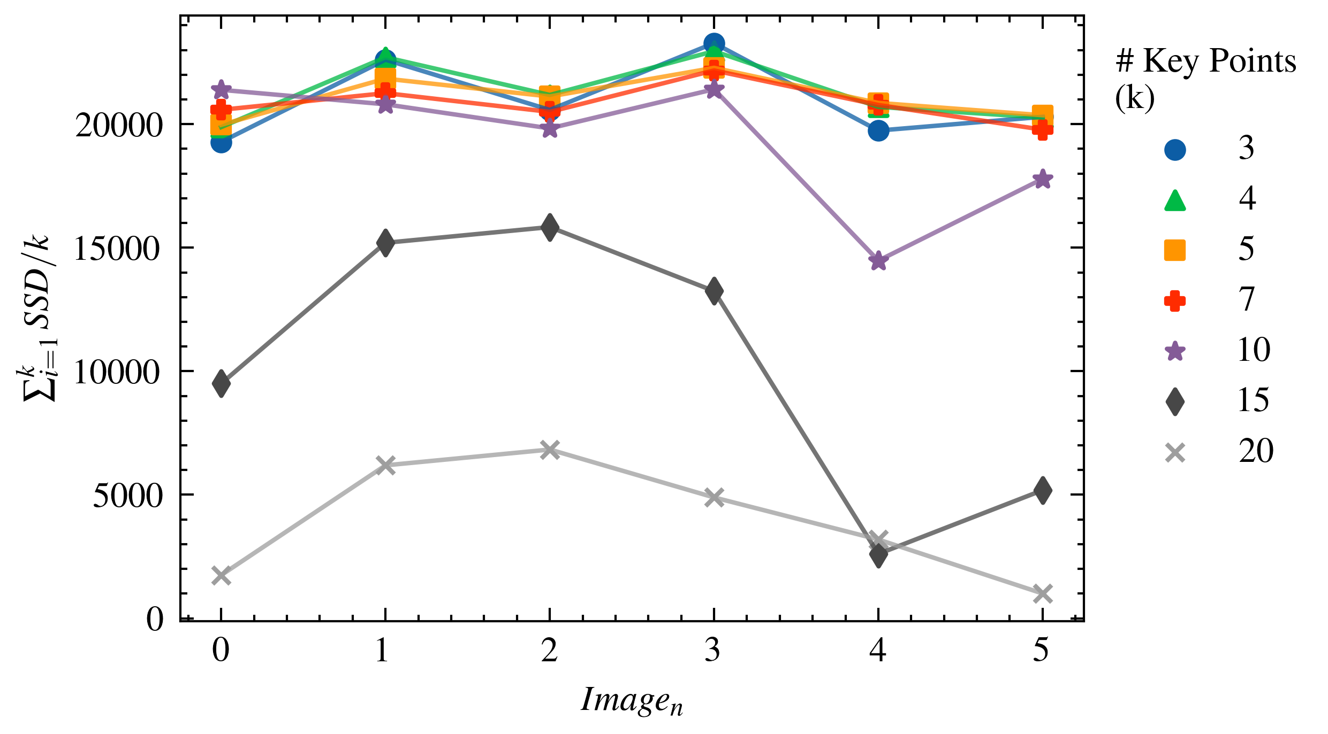
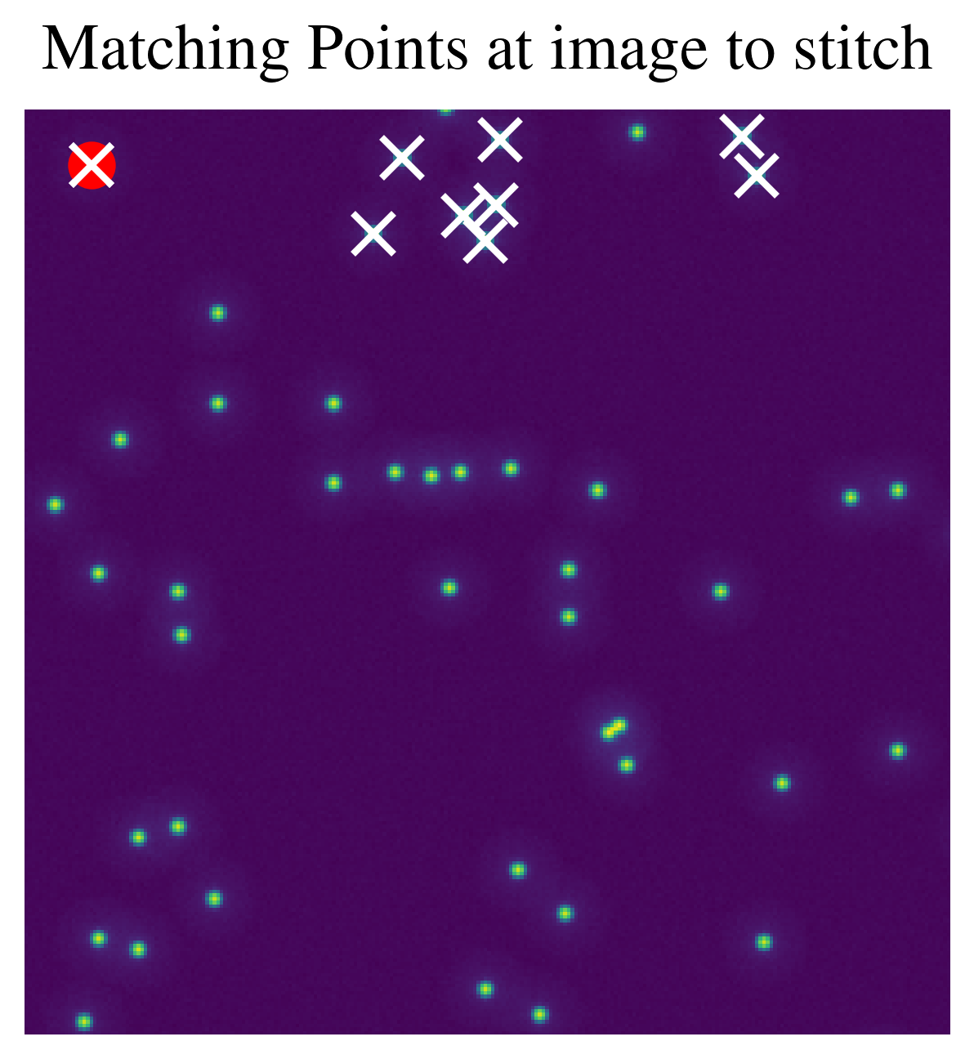
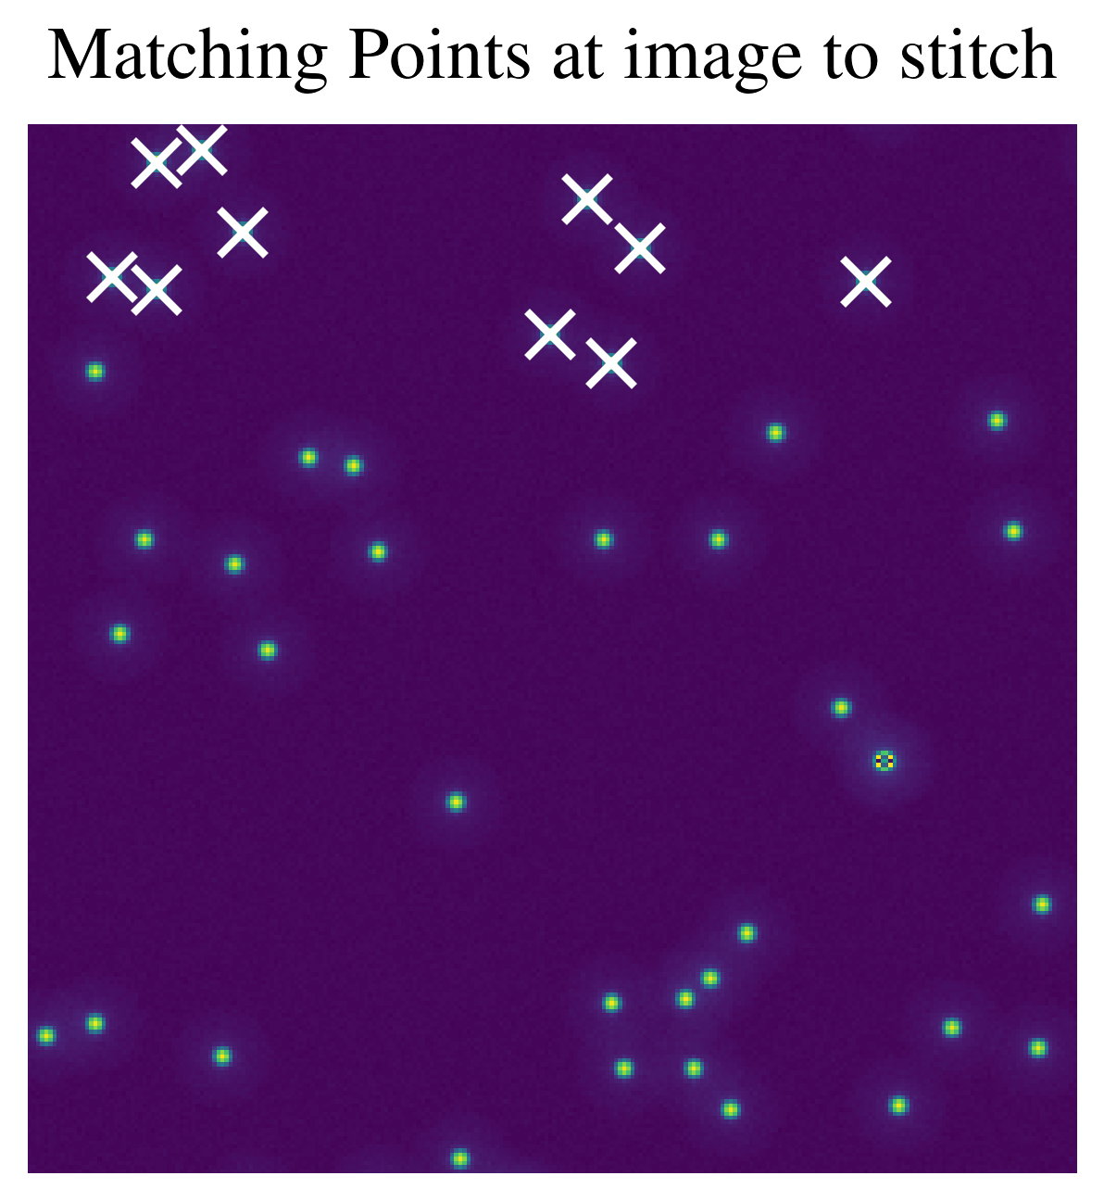
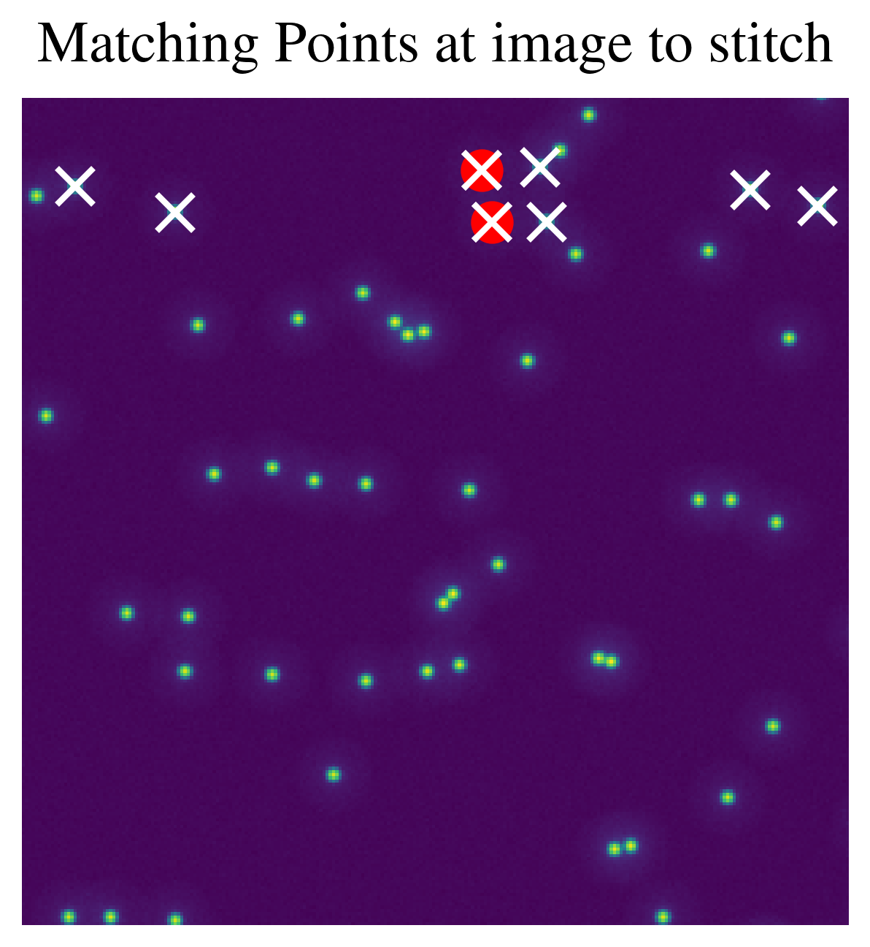
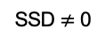
Results – Number of Key Points
Presenter: Sean
Continuous image stitching
25%
image overlap
Matching Image
50%
image overlap
Reference Image
X
Identified key point
Image_{N}
X
SSD $≠$ 0

Slide 11
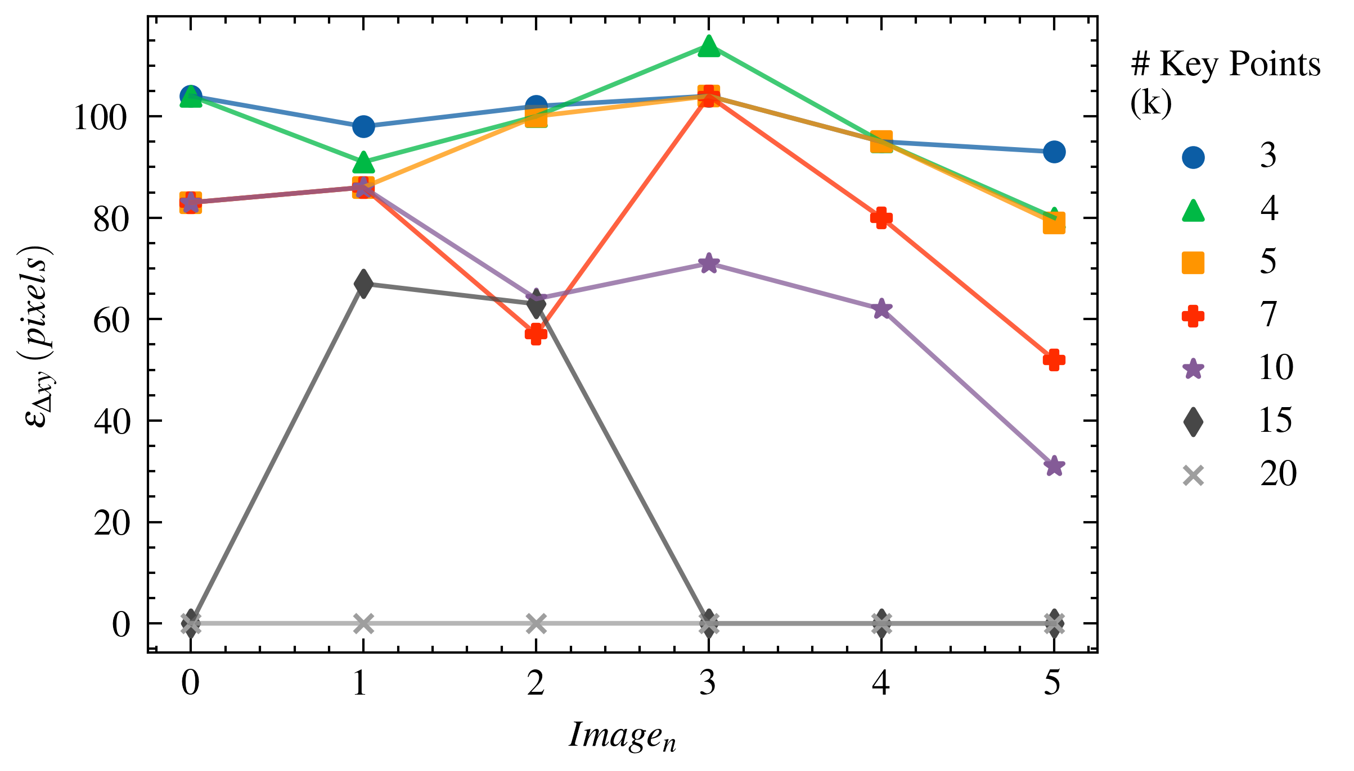
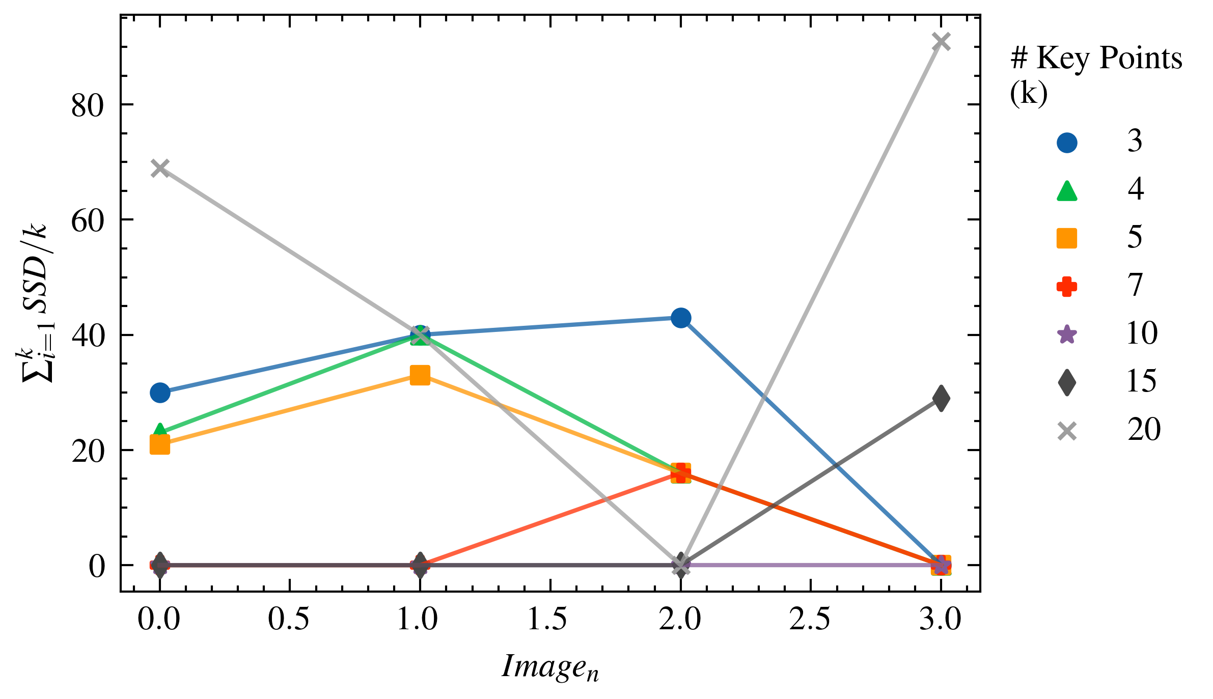
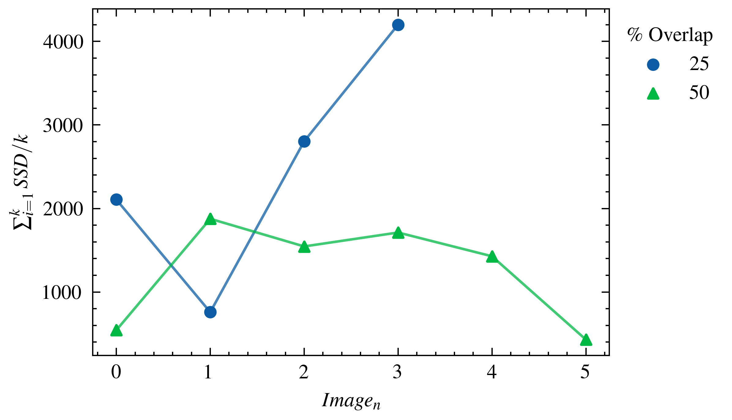
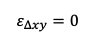
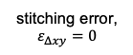
Results – Percent Image Overlap
Presenter: Sean
1. Identified two “best” stitching implementations.
2. Evaluated super widefield 2D stitching accuracy for 25% and 50% image overlap.
25%
image overlap
stitching error,
$$ε_{Δxy}=0$$
50%
image overlap
$$ε_{Δxy}=0$$

Slide 12
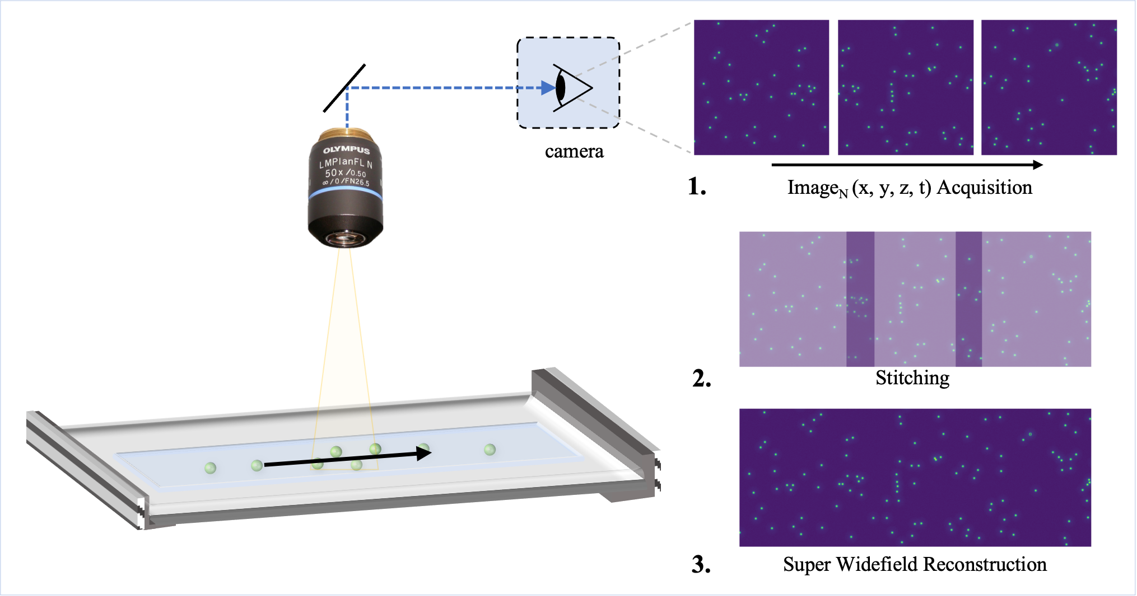
Conclusion
Presenter: Sean
Key Takeaways:
Evaluating pointwise matching accuracy is not necessarily indicative of image stitching accuracy.
→ Example: 25% overlap with DoH with 10 key points had lower matching accuracy but perfect stitching accuracy.
Increasing the # of key points generally increases accuracy.
Example: 25% overlap with DoH with 10 key points.
Increasing the image overlap generally increases the accuracy.
But perfect stitching was demonstrated at 25% overlap.
Enables faster scanning of super widefield area.

Slide 13
Thank you! Questions?

Slide 15
Supplementary Information

Slide 16
Outline
Introduction + Background
microscopes are limited by field-of-view
Solution
stitching images together to capture a widefield
Methods
Feature Detection
Difference of Gaussian (DoG), Determinant of Hessian (DoH), Corner Harris
Keypoint Preselection
Manual Input
Matching
Custom Gaussian Weighted SSD
Stitching
Post-processing Bundle Adjustment
Results and Discussion
Number of Key Points
Percent Image Overlap
Conclusion

Slide 17
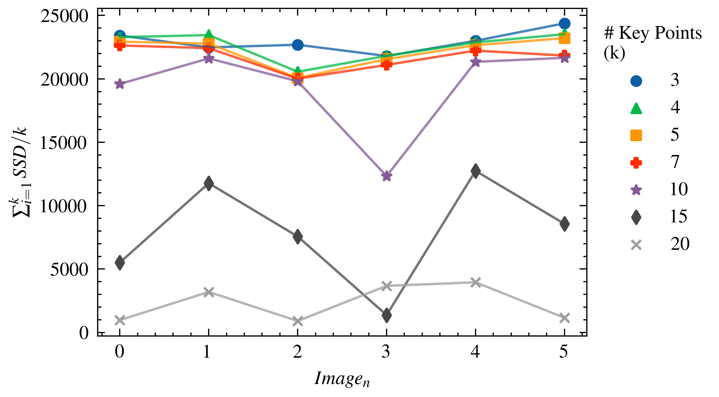
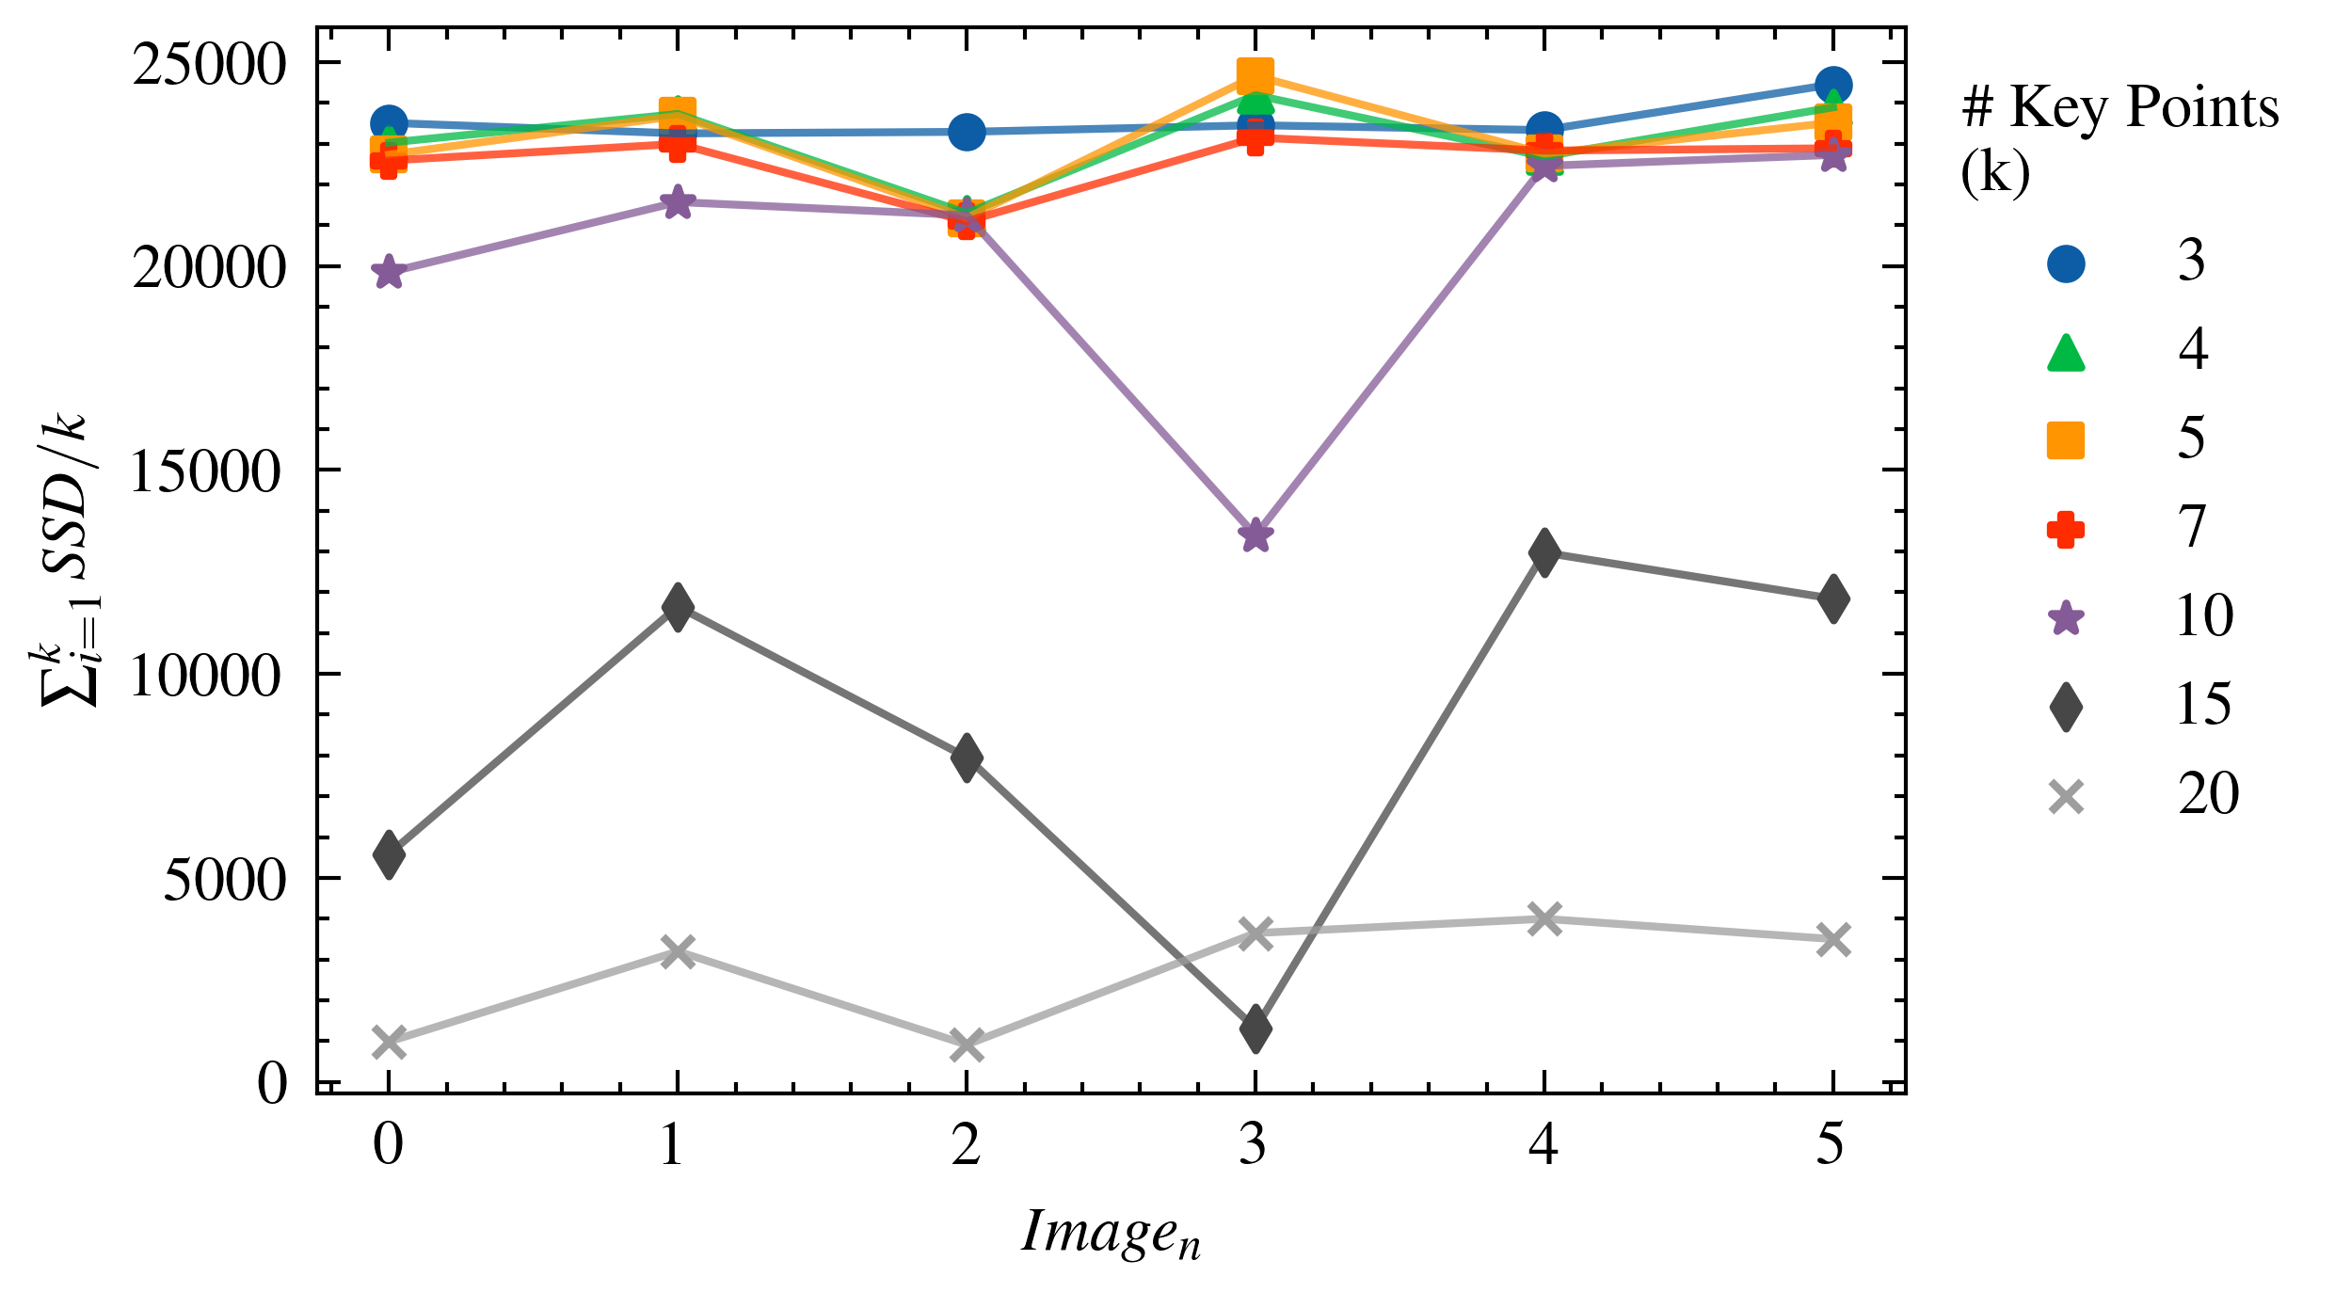
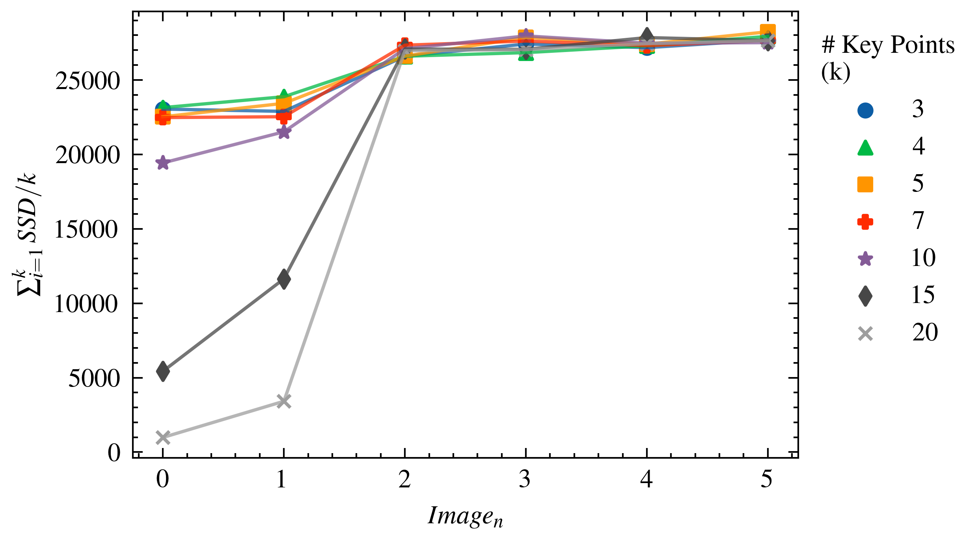
1. Feature Detection
Difference of Gaussians (DoG)
Harris Corner Detector
Determinant of Hessian (DoH)

Slide 18
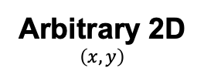
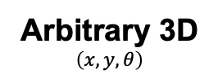
Future Directions
Present Work
Future Work
Vertical
Horizontal
Arbitrary 2D
$$\left(x, y\right)$$
Arbitrary 3D
$$\left(x, y, θ\right)$$

Slide 19
Evaluation Metrics
Metric | Variable Name | Description
Ground Truth | true_image_length | The ground truth image length.
 | true_image_width | The ground truth image width.
 | true_percent_overlap | The percent overlap of the synthetically generated images.
 | true_shift | The pixel shift described by the true percent overlap.
Inputs | input_direction | The direction of the image stitching (e.g., horizontal or vertical)
 | input_detector | The key point detector (e.g., Difference of Gaussians)
 | input_num_keypoints | The number of key points used for image stitching.
 | input_min_distance | The minimum distance (in pixels) allowable for some key point detectors.
Outputs | image_number | The image number along a stitching path where 0 is the first image.
 | num_keypoints_detected | The number of key points detected in the image.
 | num_keypoints_matching | The number of key points used for image stitchings (dependent on detection).
 | sum_ssd | The sum of the sum squared difference over all matching points between two images.
 | calc_shift | The calculated shift to stitch two images together.
 | calc_diff | A quantitative metric of the image stitching error (note: not used for evaluation).
 | calc_image_length | The reconstructed image length.
 | calc_image_width | The reconstructed image width.

